Slide 1

The Air We Breath
Jessica Woods

Slide 2



My Question to Answer-
Does Monsoons or extreme wet weather climates effect air pollution?
If so to what degree?
I narrowed my work down to just studying PM2.5 particles as those are mostly chemically compounded by actual pollution chemicals.

Slide 3
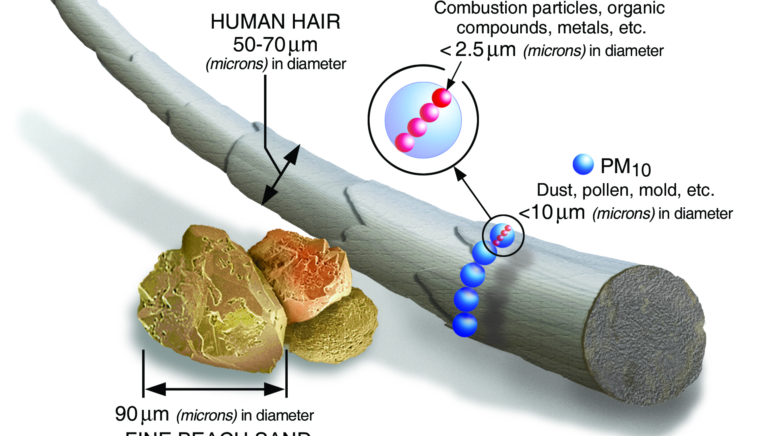
What these particles look like compared to a hair.

Slide 4
How does PM2. 5 cause death? Exposure to fine particles can also affect lung function and worsen medical conditions such as asthma and heart disease. Scientific studies have linked increases in daily PM2.5 exposure with increased respiratory and cardiovascular hospital admissions, emergency department visits and deaths. Is PM2 5 worse than smoking? 5 as bad as smoking 155 cigarettes a year, report suggests. Living for one year in an area with high levels of fine particulate matter (PM2. 5) is as bad for human health as smoking 150 cigarettes a year, according to the British Heart Foundation

Slide 5
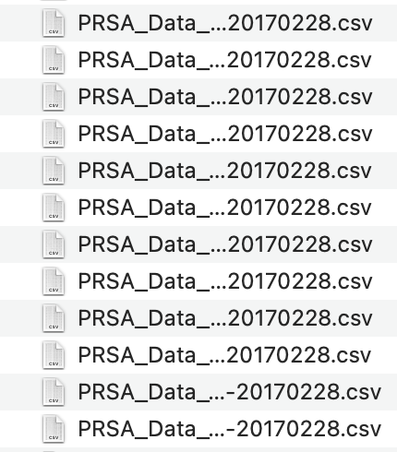

How I am going to Answer it- I am hoping Time series Data will solve these questions- parametric model Autoregression Integrated Moving Average The HO: "There is a significant difference in PM2.5 levels from monsoon season in China and India.” “Can one more month of rain make a more significant difference in air quality?”
= equals China’s data
= equals India’s data

Slide 6
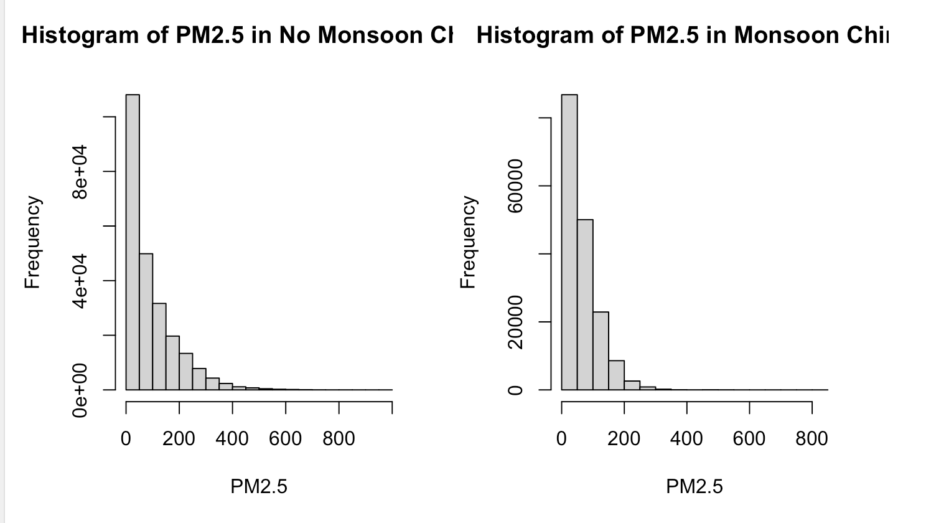
Here you can clearly see
China’s differences in
Monsoon vs No Monsoon
Over a span of
5 years reporting
On PM2.5 Particles

Slide 7
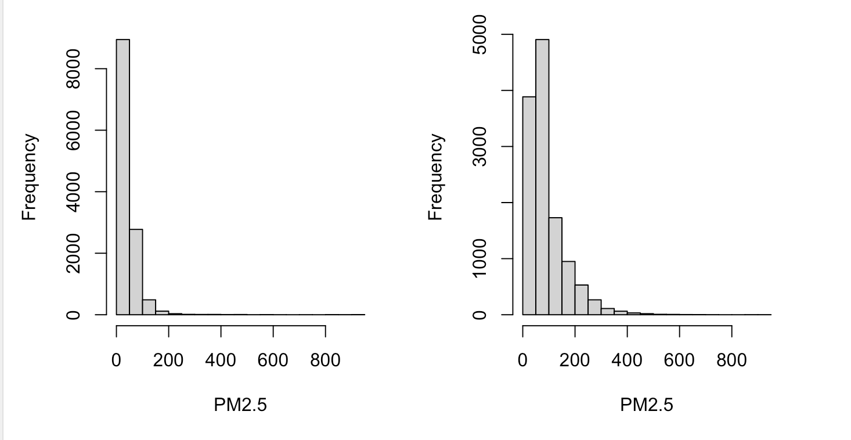
Here you can clearly see
India’s differences between
Monsoon vs No Monsoon
Over a span of
5 years reporting.
India’s No Monsoon
India’s Monsoon

Slide 8
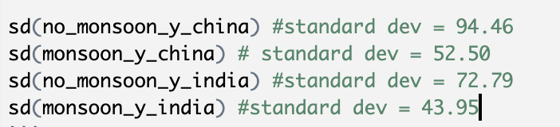
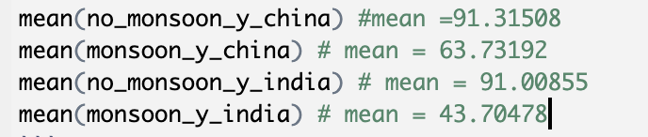
The means and standard deviation’s
Difference’s seem to support the
hypothesis.

Slide 9
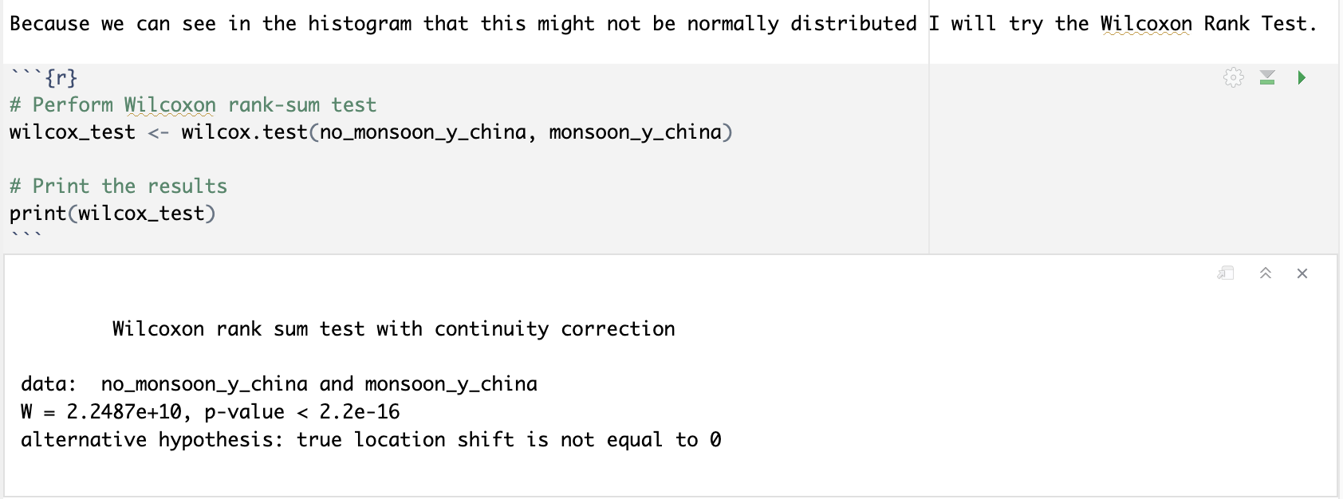
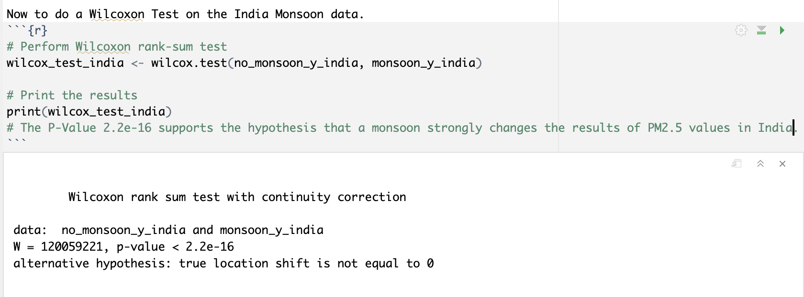
We can gather that
India and China
Both are strongly
Effected by Monsoon
Weather.
We can reject any
Hypothesis
That says otherwise
With the Wilcoxon
Rank Test statistically
Because the P-value is
Incredibly low.

Slide 10
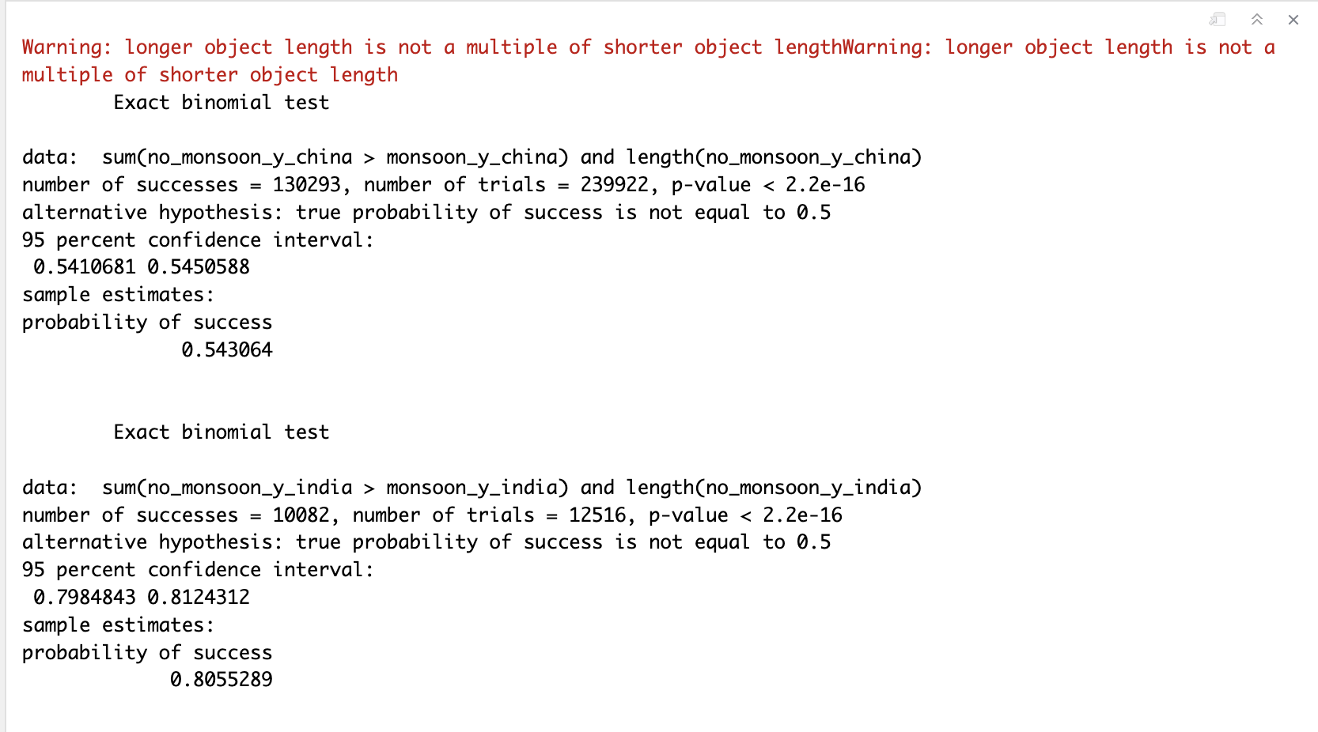
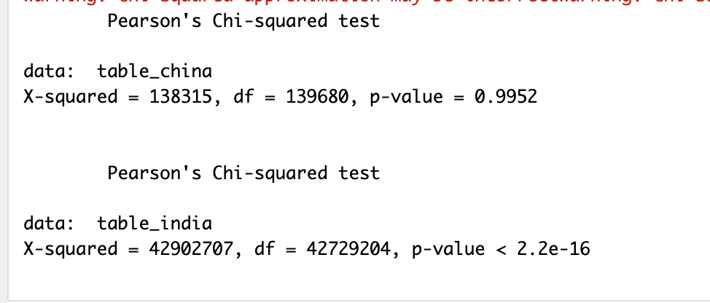
We can reject any
Hypothesis
That says otherwise
With the Sign Test statistically
Because the P-value is
Incredibly low.
But India has a greater
Probability of success than
China.
What we learn from that India
Has a greater impact from the
Monsoon season
Than China does.

Slide 11
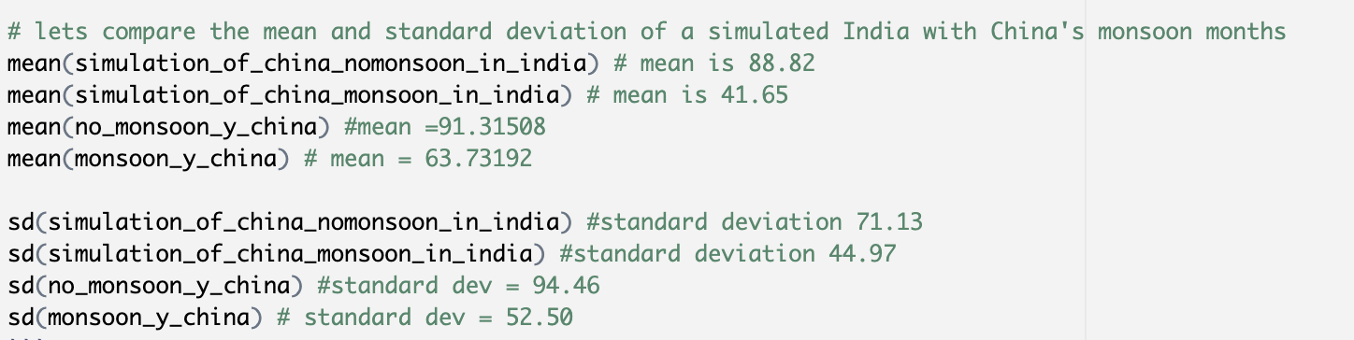
To check if one month really makes a difference in monsoon
Season I can remove April and duplicate a month of data for
April in India’s data set as no monsoon. This will either confirm
Monsoon is more effective or confirm habitats
Are more effective, such as communal vs industrial.

Slide 12
A new HO: can be derived from this that, industrial living
Has a greater negative impact on air quality
Than the monsoon has on bringing the quality of air
To a lower state.
As China is more industrial than India. One month with or without rain
would not change the outcome of the air quality differences between China and India

Slide 13
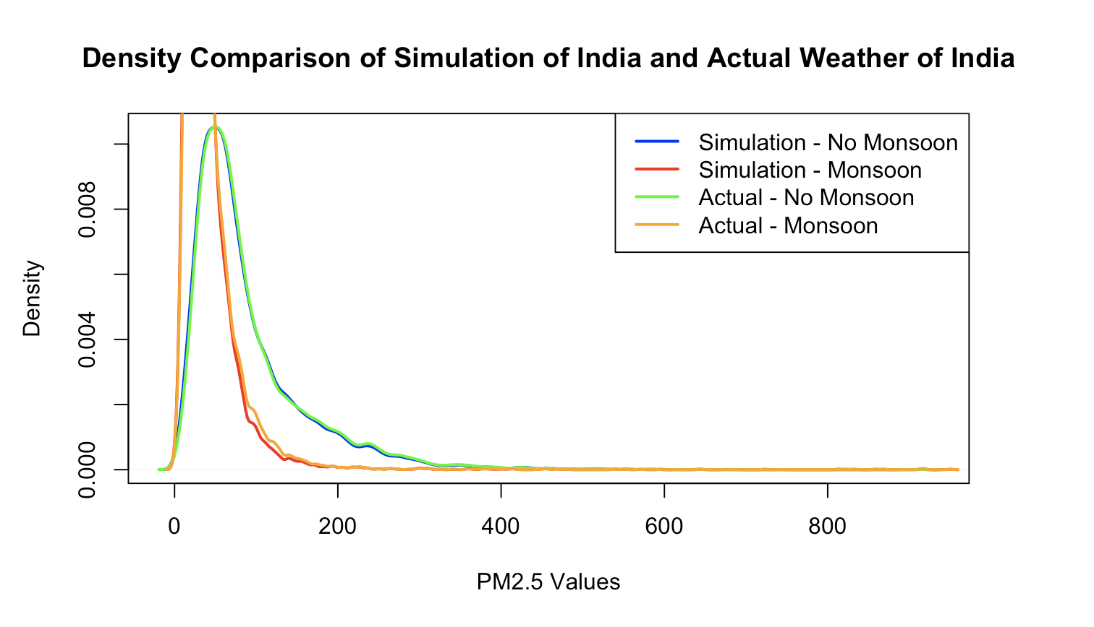
Density curve of India showing the results to be the same.

Slide 14
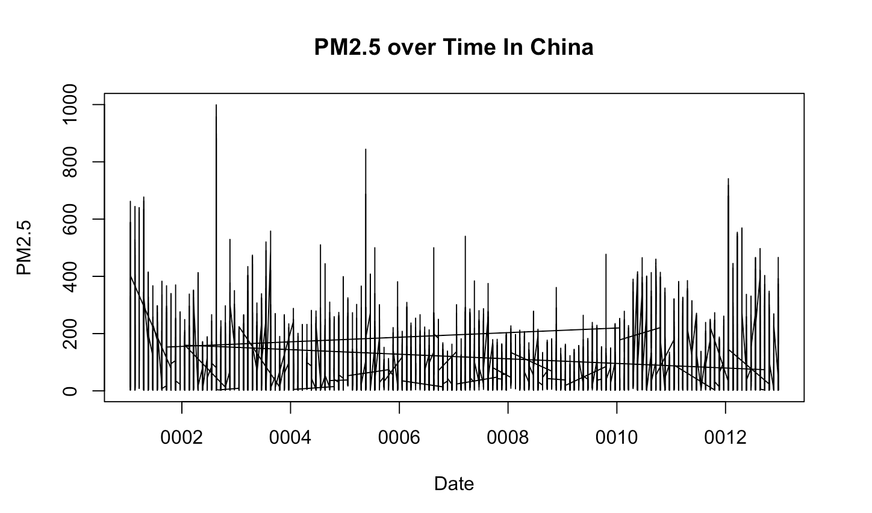
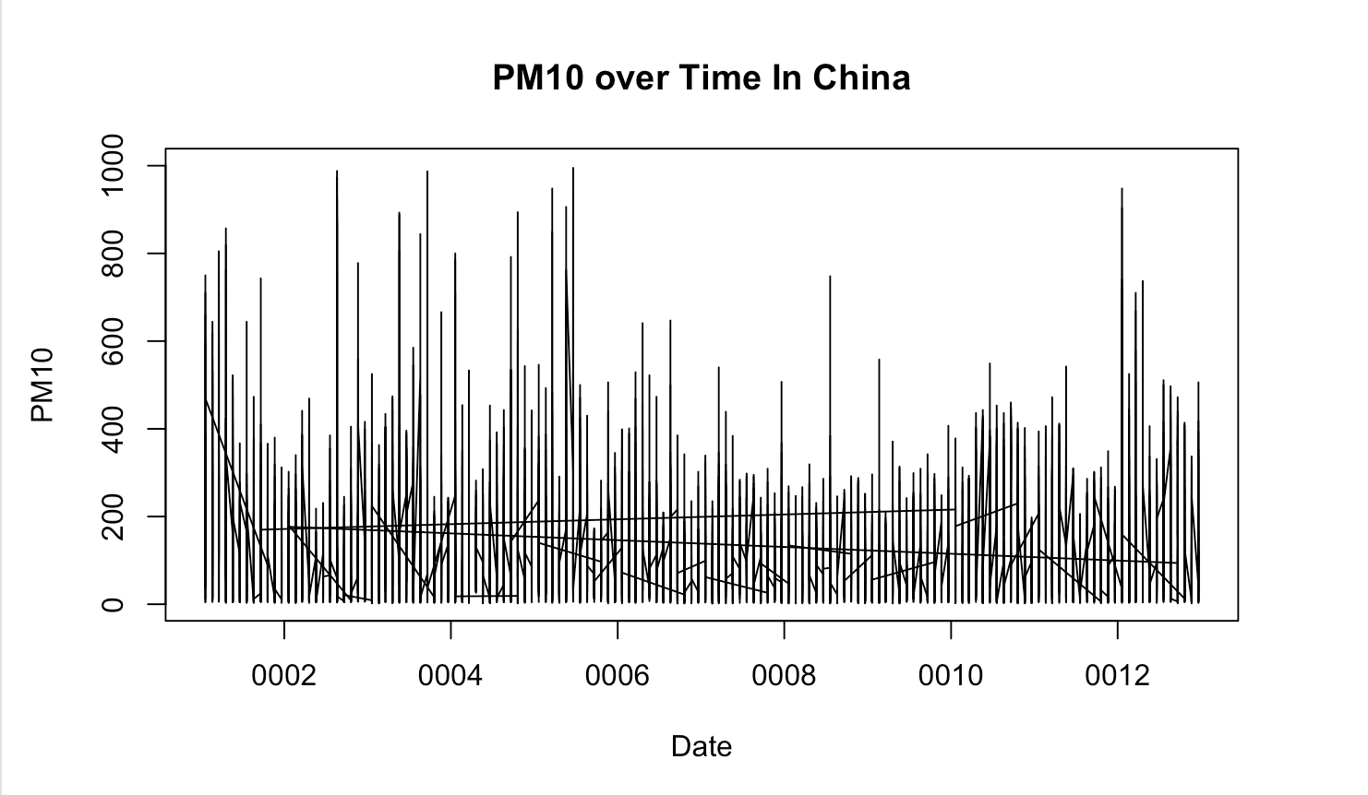
I found PM10 measurements to hold a rather scary amount of consistency regardless of the weather. So this is why I chose to focus on PM2.5. It promises greater diversity and questioning.

Slide 15
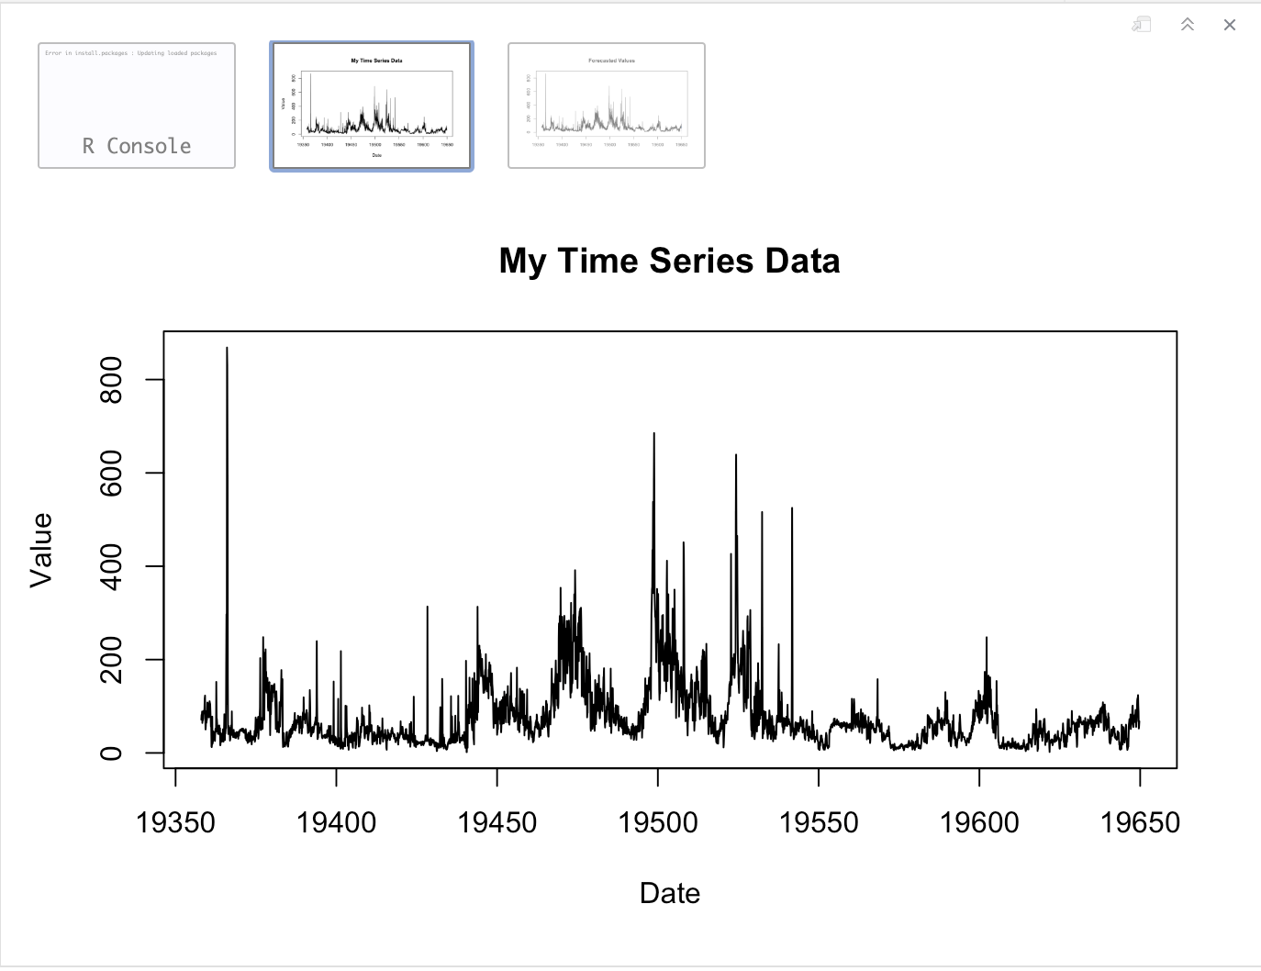
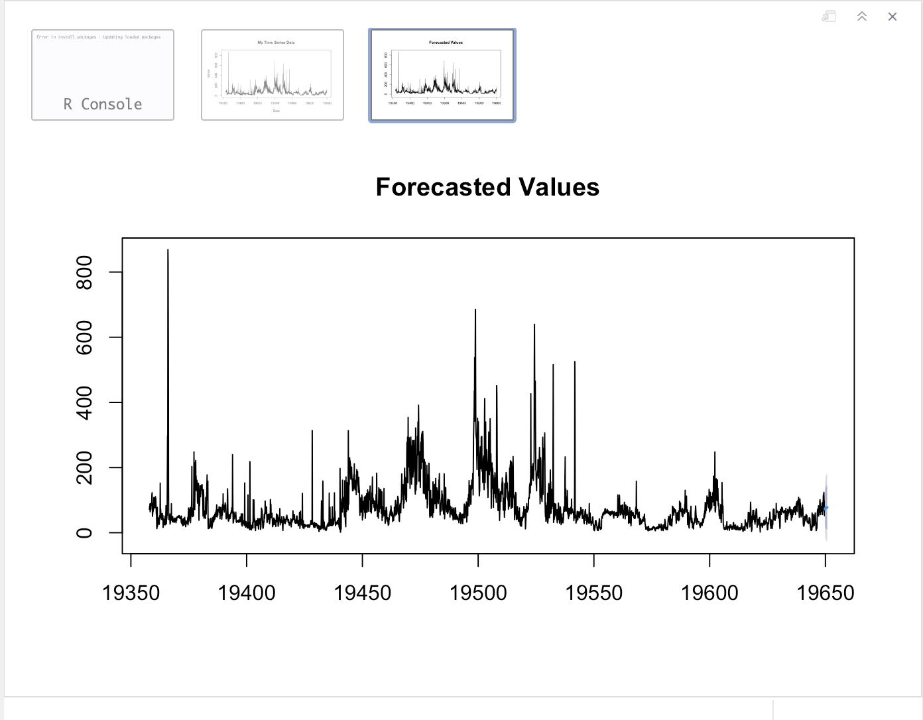
Forecasting
2015
2016
2017
2018
2020
China & India
I tried to do this with China and it failed…
this is however the results of India 2023 PM2.5 levels- as it will be the same
As long as India continues to stay communal and not get industrial.

Slide 16
Content
India Data:
China Data:
https://www.kaggle.com/datasets/rohanrao/air-quality-data-in-india
https://www.kaggle.com/datasets/sid321axn/beijing-multisite-airquality-data-set
Personal note: “na’s pop up everywhere and in places I didn’t want to see, like making a frustrating mean() = NA, how did that happen, well it does. Working with dates is fishy work when they are all loaded as Chr’s or separated in different columns on a csv file.”

Slide 17
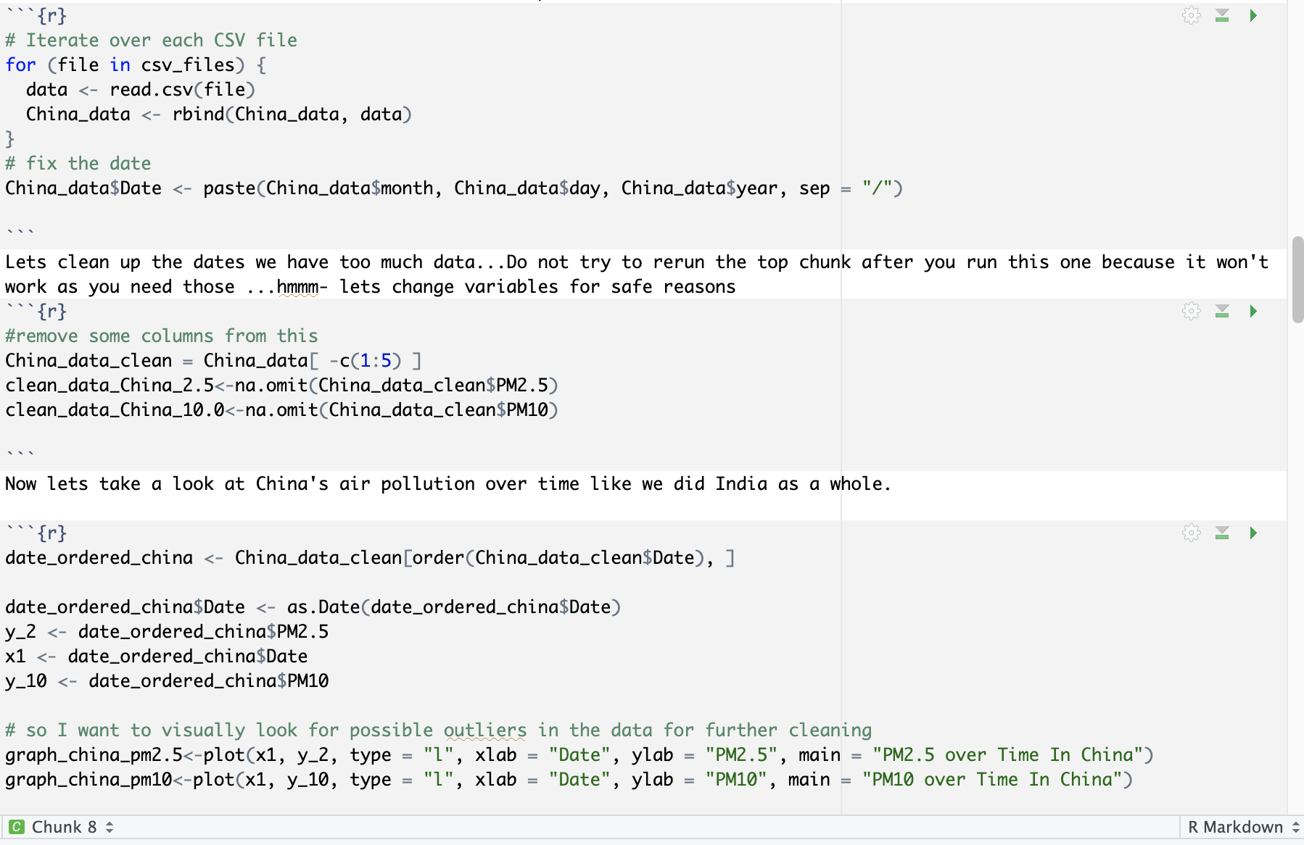
Summary
Statistically speaking all tests point to support my personal hypothesis that monsoons greatly effect the pollution levels in the air of India and China. More so in India than in China. This could be from one more additional month of rain, but that was statically tested in a simulation, so it is due communal efforts made by India.
Most studies indicate PM2. 5 at or below 12 μg/m3 is considered healthy with little to no risk from exposure. If the level goes to or above 35 μg/m3 during a 24-hour period, the air is considered unhealthy and can cause issues for people with existing breathing issues such as asthma.

